Slide 1

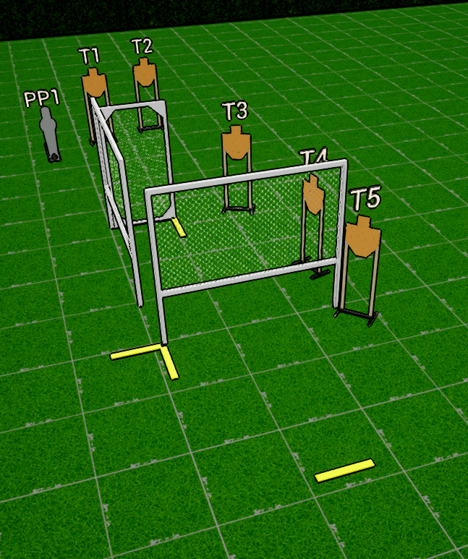
 | Interlake Sporting Association Action Bay, B Stage: Untitled Course Designer: Nathan Jarvis
SCENARIO: We made a kid come up with something to torture adults.
START POSITION: Standing with toes touching start line. Gun loaded and holstered, wrists below belt. PCC Loaded, safety on. Stock touching belt with muzzle pointed downrange |  | STRINGS: 1 SCORING: Unlimited ROUND COUNT: 6 START-STOP: Audible - Last shot
STAGE PROCEDURE: At the start signal, engage T5 in the open. Engage remaining targets from available cover positions. T1/T2 may not be engaged from P1 or P2
P3
P2
P1

